Slide 1

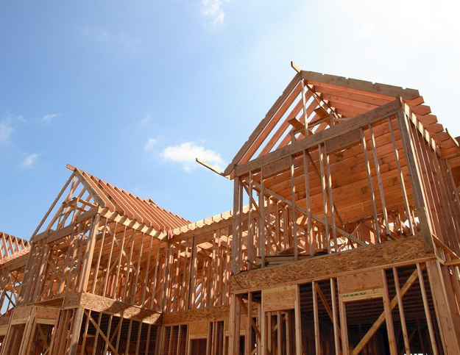

YOUR TEAM
Is Your Property Destine for New Construction?
New Construction within Established Communities
Sell to
the most likely
buyers
Hassle-free
and “as-is”
Showings are
optional
Fair fee
xxx-xxx-xxxx In Partnership with
Jane.Doe@YourTeam.com 123 Lead Lane, YourTown

